Slide 1
Problem identification
Big Mountain Resort offers spectacular views of Glacier National
Recently Installed additional chair lift Increases the operational cost by $1,540,000
Big Mountaind needs to comes up with a better value for the ticket
Focusing on multiple factor

Slide 2
Recommendation and key findings
The ticket price on weekend and weekday can be kept same
With a current price of $81.00 and an average of 350,000 customers, operational costs of the chair lift will be covered.
There are some feature that doesn't require for the prediction.

Slide 3
Modeling results and analysis
The random forest model has a lower cross-validation mean absolute error by almost $1
performance on the test set produces performance consistent with the cross-validation results.
The cross validation levelled off by around a sample size of 40-50

Slide 4
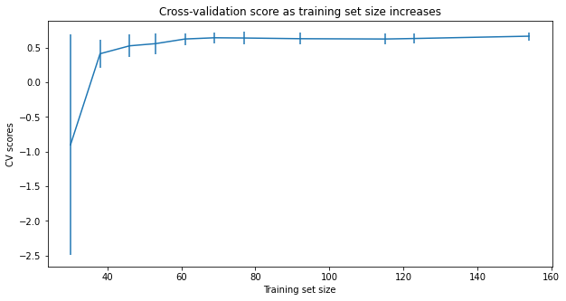

Slide 5
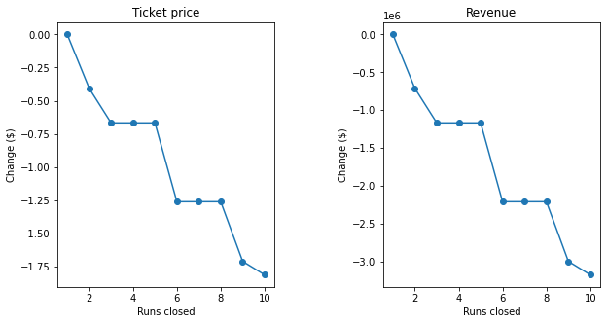
Big Mountain Resort has been reviewing potential scenarios for either cutting costs or increasing revenue
The first scenario shows closing the run 3 or 6 would support ticket price and revanue also

Slide 6
In second Scenario Big Mountain is adding a run, increasing the vertical drop by 150 feet
This scenario increases support for ticket price by $1.99
The third scenario of adding 2 acre of snow making support for ticket price by $1.99
Fourth scenario calls for increasing the longest run by .2 miles a guaranteeing its snow by adding 4 acres of snow

Slide 7
Results
The greatest influence which can be seen as the coeffcient amoungst all the features proved to be the adult weekday price.
Although the longest run feature was used in the linear model, the random forest model (the one we chose because of its better performance) only has longest run way down in the feature importance list.

Slide 8
Summary
Big Mountain currently charge 81.00.𝑇ℎ𝑒𝑝𝑟𝑒𝑑𝑖𝑐𝑡𝑒𝑑𝑝𝑟𝑖𝑐𝑒𝑐𝑜𝑚𝑒𝑠𝑜𝑢𝑡𝑓𝑟𝑜𝑚𝑚𝑜𝑑𝑒𝑙𝑖𝑠81.00.Thepredictedpricecomesoutfrommodelis92.35 with mean absolute error of 10.39. There are four senarious deduces from the model. first of all close least used runs. Second and third is increase the vertical top, and calls for increasing the longest run by .2 miles and guaranteeing its snow coverage by adding 4 acres of snow making capability. The addditional cost for installing new chai scenario increases support for ticket price by 1.99𝑂𝑣𝑒𝑟𝑡ℎ𝑒𝑠𝑒𝑎𝑠𝑜𝑛,𝑡ℎ𝑖𝑠𝑐𝑜𝑢𝑙𝑑𝑏𝑒𝑒𝑥𝑝𝑒𝑐𝑡𝑒𝑑𝑡𝑜𝑎𝑚𝑜𝑢𝑛𝑡𝑡𝑜1.99Overtheseason,thiscouldbeexpectedtoamountto3474638. The price is expected on the basis of certain features under no real market senario, they may be more columns like operational cost etc. required for real senario.

